Slide 1



Real World Scalability
Mark Doyle
mark.doyle@collabroscape.com
@mark_doyle_ftw
linkedin.com/in/spencermarkdoyle
Materials on GitHub: github.com/mark-doyle/dal-cs-sig

Slide 2
What is Scalability?
Writing better or more performant code | Thoughtful, efficient code Asynchronous programming Parallelism Code analysis
Implementing improved architecture or design | Data / calculation storage Disconnected / async processing Caching Compression
Hardware or environment solutions | Data center considerations Scale up Scale out

Slide 3

Asynchronous Programming
Async / Await
PROS | CONS
Frees up main thread during network/storage operations Beneficial for network- or storage-intensive solutions | Challenging to partially implement Deadlocking potential Thread pool management performance Little benefit to single-threaded or CPU-intensive solutions

Slide 4


Parallelism
Without async / await
With async / await

Slide 5

Caching
In-memory caching
PROS | CONS
Readily-accessible objects & data Faster access than network-based resources Fewer storage transactions Lower cost* | Memory pressure expiring cache Stale objects

Slide 6
Caching (continued)
Distributed cache (e.g., Redis, Memcached)
Hybrid cache (in-memory + distributed)
PROS | CONS
Cache accessible to numerous processes / machines Fewer storage transactions | Network-based resource (more network transactions) Cost Serialization

Slide 7
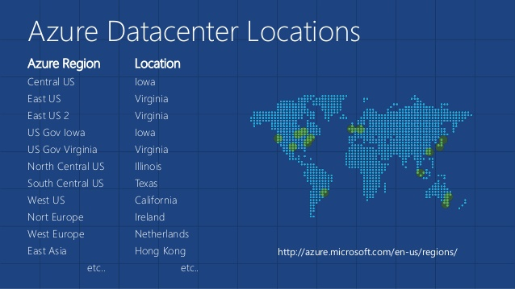
Data Center Considerations
Proximity matters: Same location = low latency

Slide 8
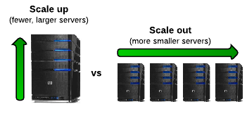
Scaling
PROS | CONS
Better performance | Cost Idle hardware (unless auto-scaling)

Slide 9
Load / Performance Testing
“The best time to begin load testing was two iterations ago. The second best time is now”
- Ancient Proverb

Slide 10
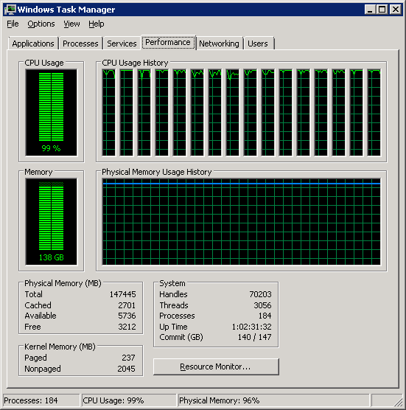
Performance Testing – Old School
Perfmon
CPU Utilization
Memory Utilization
Network Utilization

Slide 11
Load Testing
Duration & User Load
Test Mix
Run: Local vs Cloud
See the code…

Slide 12
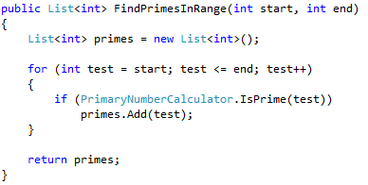
Problem 1 – CPU Bound Operations
Example: Primary number calculation

Slide 13
Problem 1 – CPU Bound Operations
Solution 2: Async/await, no caching
Solution 3: Caching, no async/await
Solution 4: Caching, with async/await

Slide 14
Problem 1 – CPU Bound Operations
See the code…

Slide 15
Problem 1 – CPU Bound Operations
Results
Test | Cached | Async
Baseline
Cached | Y
Async |  | Y
Cached/Async | Y | Y

Slide 16
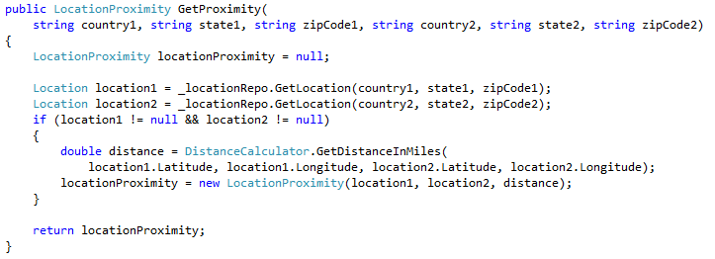
Problem 2 – Storage Read with CPU
Example: Proximity calculation between two locations

Slide 17
Problem 2 – Storage Read with CPU
Solution variables
Synchronous versus async/await
Storing results
Caching
Pre-loading locations

Slide 18
Problem 2 – Storage Read with CPU
See the code…

Slide 19
Problem 2 – Storage Read with CPU
Results
Test | Stored | Cached | Async | Pre-load
Baseline
Stored | Y
Cached | Y | Y
Preload | Y | Y |  | Y
Async |  |  | Y
Async/Stored | Y |  | Y
Async/Cached | Y | Y | Y
Async/Preload | Y | Y | Y | Y

Slide 20
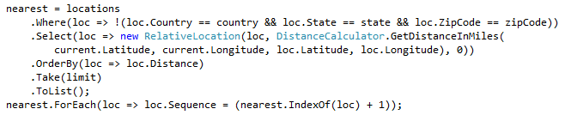
Problem 3 – Large Dataset Calculations
Example: Find closest locations

Slide 21
Problem 3 – Large Dataset Calculations
Solution 2: Async/await, no caching
Solution 3: Distributed caching, no async/await
Solution 4: Distributed caching, with async/await

Slide 22
Problem 3 – Large Dataset Calculations
See the code…

Slide 23
Problem 3 – Large Dataset Calculations
Results
Test | Cached | Async
Baseline | No | No
Cached | Yes | No
Async | No | Yes
Async/Cached | Yes | Yes

Slide 24
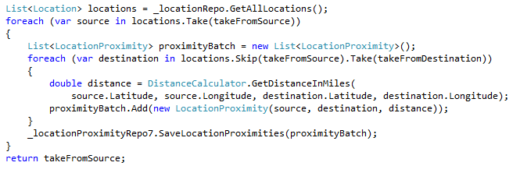
Problem 4 – Storage Bound Operations
Example: Calculate proximity of range of locations
Solution 2: Async/await

Slide 25
Problem 4 – Storage Bound Operations
See the code…

Slide 26
Problem 4 – Storage Bound Operations
Results
Test | Async
Baseline
Async | Y

Slide 27
What About Scale?
Scaling UP amplified caching & async improvements
more than scaling OUT

Slide 28
More Scaling Results

Slide 29
Conclusion
Load Testing
Load testing is cyclical – build, test, adjust, repeat
If possible, run using Visual Studio Team Services (in Azure)
Try various scenarios
surge vs gradual usage
sporadic vs sustained
Verbose logging, if possible
stopwatch timings
data queries

Slide 30
Conclusion (continued)
Caching
Determine forced expiration vs timed expiration
In-memory vs distributed vs hybrid
Redis
https://azure.microsoft.com/en-us/services/cache/
https://github.com/StackExchange/StackExchange.Redis

Slide 31
Conclusion (continued)
Asynchronous / Parallel Processing
Not always ideal
Can better balance load
high-volume threading scenarios
high-volume network- or storage-intensive operations
More info: http://blog.stephencleary.com/

Slide 32
Conclusion (continued)
Scaling
Find minimum acceptable “scale up” for off-peak, then scale out
Take advantage of auto-scaling, if possible
Load-based
Time-based
Special scenarios
Azure Auto-scaling:
https://azure.microsoft.com/en-us/documentation/articles/cloud-services-how-to-scale/

Slide 33
Questions or Comments?
Mark Doyle
mark.doyle@improving.com
@mark_doyle_ftw
linkedin.com/in/spencermarkdoyle

